Slide 1
Session - 4

Slide 2
File Handling

Slide 3
VSAM
Different types of VSAM Datasets used in CICS are :
ESDS Entry Sequenced Dataset
KSDS Key Sequenced Dataset
RRDS Relative Record Dataset
Notes:
Lets have a review of the VSAM files which are being used in CICS.
The Access Methods Supported by CICS are:
1. BDAM (Basic Direct Access Method)
2. VSAM. (Virtual Storage Access Method)
This Course will cover VSAM Only.
KSDS (Key-Sequence Dataset) :- The records in this Dataset are identified by a Key, key of each record is simply a field in a predefined position in the record. The logical order of the records depends on the sequence of the key. VSAM creates and maintains Index, to find the physical location of a Record.
ESDS (Entry-Sequenced Dataset) :- The records in this are identified by the Relative Byte Address (RBA) and will be held in order they were first dataset into the File. The Records cannot be Deleted.
RRDS (Relative Record Dataset) :- RRDS has fixed-length slots, in which records are stored. Each record is identified by RRN, Relative Record Number. While a new record is added, the RRN has to be supplied with the record.
VSAM allows alternate index AIX for KSDS or ESDS but not RRDS. The AIX can have duplicates in it. To access the records using the alternate key, you have to Define Alternate Index Path.

Slide 4
Services provided by CICS
Basic Operations required for a file are
    Adding a Record.
    Modifying an Existing Record.
    Deleting an Existing Record.
    Browsing One or Selected or All Records.
In Addition, CICS Provides
    Exclusive Control. (Record Level Locking).
    Data Independence.
    Journaling.
    Opening and closing Files.
Notes:
Some of the Basic Operations required for a file are:
Adding a Record.
Modifying an Existing Record.
Deleting an Existing Record.
Browsing One or Selected or All Records.
CICS also provides certain features like data independence, exclusive control, journaling, opening and closing of files.
Data Independence : The Program is independent of the structure of the File. The Data can be accessed using any format in Application Programs.
Exclusive Control : When One Task has read a Record for update it, another Task cannot read the same Record.
Opening and Closing of Files : The file open or close is a CICS task. It should be done using the Master Terminal transaction. It should be ensured that Before accessing a file, it should be ENABLED. Files are opened dynamically by CICS when the file is first accessed, and closed when CICS is brought down. CICS application Program should never open or close a File.
Journalling : It is similar to System Log. While Processing a Transaction, CICS writes the Updated Record into the Journal after each Update is done, which is used for recovery purpose in case of failures. The Journal should be defined in JCT.

Slide 5
Defining Files
In CICS, Files Cannot be Created, Files can be created using IDCAMS Utility.
Re-indexing, Creating new indexes, etc. should be done using IDCAMS Only.
Notes:
As far as CICS is concerned we don’t have separate commands to create and open the files in the application program. The files should be created using IDCAMS utility only. The file referred by the file-id can be loaded in the CICS region and can be opened and enabled for all operations to be done on the file. The same is applicable while creating indexes as well.

Slide 6
Defining a file to CICS
Files should be defined in FCT (File Control Table).
FCT will contain all the Information about a File. (like dataset name, access methods, permissible file service request, etc.)
Defining Files can be done either by CEDA Transaction or DFHFCT Macro.
Notes:
In Programs, it is assumed that all required entries are available in FCT. Only the File-Name, key-field and the Data-area name will be given in program. The File Name should be at the most 8 characters. Different Filename can be used to refer the same Physical file i.e. a Dataset.

Slide 7
Syntax of DFHFCT Macro
DFHFCT TYPE=FILE,ACCMETH=VSAM,
    DATASETNAME=NAME, SERVRQ=(ADD,BROWSE,DELETE,READ,UPDATE),
    FILSTAT=(ENABLED,OPENED)
Notes:
For Remote Datasets, Remote and SYSID are must to identify the files.

Slide 8
File Handling in Programs
Files should not be defined in the Program.
Program should not open or close a File.
Records can be written in any order. A number of records can be added at a time.
Records can be inserted, updated or deleted.
Notes:
File Handling in Programs :
Files used by CICS are opened dynamically when they are closed and enabled and they are closed automatically when the CICS Region is brought down. They can also be closed by SET or Master Terminal Commands.
During Batch Jobs, if the files are shared between CICS and Batch Programs and if the files require any updating, they should be closed in CICS before submitting the job.

Slide 9
Important keywords
Dataset/File :- Name in the FCT.
Into/From (WS-Rec) :- Working-Storage Area defined in the program where the CICS Puts/Gets the Data.
RIDFLD :- Contains the Record Key.
RESP :- Contains the return code of the executed command.
LENGTH :- Length of the Record to be Retrieved or Written.
Notes:
FROM/INTO (WS-Rec) :- Using which the data is read or written into the files.
RIDFLD contains the key of the record to be read from or written into the file.
RESP can be included for all CICS commands and tested following the execution of command. This field should be Full word Binary (S9(08) Comp-3). This field will give the status of the command execution.
Length :- length of the data area into or from which the record is read/write. After the command execution, the actual length of the record is available in this field. (halfword Binary S9(04) Comp-3).

Slide 10
Random Read
Move 1010 to rec-key
EXEC CICS READ
File(ozags1f)
[Into(ws05-rec)]
RIDFLD(Rec-Key)
generic
GTEQ
END-EXEC.
Condition: DISABLED, NOTOPEN, NOTFND, LENGERR, DUPKEY, IOERR.
Notes:
Ref: https://www.ibm.com/docs/en/cics-ts/5.4?topic=summary-read
For Fixed Length Records, the Working-Storage Area should be of defined length.
Records can be read Sequentially or Randomly
For Variable Length records, the Read command should specify the length of the Working-Storage Area provided.
The Complete Syntax of Read command is :
READ File(filename) SYsid() Optional
SEt() | Into() Length(Rec-Len) Optional
RIdfld(Rec-Key) Keylength() Optional
GEneric Optional
RBa | RRn | DEBRec | DEBKey Optional
GTeq | Equal Default is Equal,
Update Optional
SYSID() : If the file is in a Different System, you can specify the SYSID.
SET()|into() :- INTO( ) will specify the record is to be read into an Area provided by Program. SET( ) will update the CICS SET storage address acquired by File Control to the Area specified. SET option is more preferable, as it is more fast as well as saves memory.
UPDATE :- This option Reads the Record and will lock it, so that other Users or Transactions cannot Read the Record. This will be done before Re-Writing or Deleting the Record.
GENERIC :- When the File is accessed using Partial Key, i.e. when the Key Length in the file is less than the actual length, we can Read all Records which are starting with Same Initial Characters.
DISABLED :- Occurs when the File is Disabled. This can be resolved by Enabling the File.
DUPKEY :- Occurs when the Read With Generic is used.
IOERR :- Occurs if there is any input-output error
LENGERR :-
- The Length of the Record Read is MORE than the Value specified in the LENGTH option.
-Neither the LENGTH option nor the SET option is specified on a READ command for a file with variable-length records or for a BDAM file with undefined format records.
NOTFND :- When the Record with the Specified Key is not PRESENT.
NOTOPEN :- Occurs when the File is Closed and Un-Enabled/Disabled..

Slide 11
Example for Random Read
EXEC CICS READ
File( ‘MAPLE41F ')
Into(WS-EMP-REC)
Length(WS-EMP-LEN)
RIdfld('7135950602') | RIdfld(WS- EMP-KEY)
END-EXEC.
Notes:
MAPLE41F is assumed to be the File Name as defined in FCT.
WS-EMP-REC is a Working-Storage Group Variable.
WS-EMP-LEN contains the Length of the Record.
WS-EMP-KEY contains the Key of the Record to be Read.
( The key value can also be directly passed in the RIDFLD if its known)

Slide 12
Sequential Read
Sequential Read is done by Browse Oper.
Establish the pointer to the First Record to be Read Using StartBr.
Next and Previous Records can be Read as required Using ReadNext and ReadPrev.
End the Browse Operation at last.
Browse can be re-positioned.
During Browse Operation, Records cannot be Updated.
Notes:
STARTBR identifies the Starting Position of the Browse operation. It will not read any record. Records following are read by the READNEXT and before are read by READPREV. The direction can be changed as required, i.e. after some ReadNext, ReadPrev can be issued. By giving X’00’ in the RIDFLD, the pointer is set to first record and X’FF’ to the last record in the file. When using Generic key, only forward Browse is allowed, READPrev will give INVREQ.
Browsing a KSDS or ESDS can also be done using the alternate index path. If there are duplicate records, DUPKEY handle condition will be raised, except for the last occurrence of the record. The order of retrieving the duplicate records are the same as they were entered into the file.

Slide 13
Syntax for STARTBR
EXEC CICS STARTBR
FILE(filename)
RIDFLD(data-area)
END-EXEC.
Condition : DISABLED, IOERR, NOTFND, NOTOPEN.
Notes:
The complete Syntax of STARTBRowse is :-
EXEC CICS
STARTBR FILE(filename)
RIDFLD(data-area)
KEYLENGTH(key-value) Optional
GENERIC Optional
REQID(data-value) Optional
SYSID(name) Optional
RBA|RRN|DEBKEY|DEBREC Optional
GTEQ|EQUAL Optional
END-EXEC.
REQID :- This is a Half-Word Binary, used as a Unique Request Identifier of the execution of the command. Using the REQID, simultaneously the Program can have more than one Browse in it, at the same time on the same file. You can distinguish the browse operation by including the REQID option on each browse.

Slide 14
Reading the Record after STARTBR
Sequentially the Next or Previous Record can be read by a READNEXT or READPREV.
The first READNEXT or READPREV will read the Record where the STARTBR has positioned the File Pointer.
Notes:
Requires a Successful Completion of STARTBR, RIDFLD will contain the Record Key after Read.
While Browsing, the pointer can be re-positioned simply by giving the new key in the RIDFLD or by changing the key length. By this way, some records can be skipped. But, when there is a big change using RESETBr is advisable.

Slide 15
Syntax of READNEXT/ READPREV
EXEC CICS READNext | READPrev
  FILE(name)
  INTO(data-area)
  RIDFLD(data-area)
  resp(ws-resp)
END-EXEC.
  If ws-resp= dfhresp(endfile)
Condition : DUPKEY, ENDFILE, IOERR, LENGERR, NOTFND.
Notes:
For ReadNext, Endfile occurs after the Last Record in the File is read and for ReadPrev, after the First Record is read.
INVREQ arises when either READPrev or READNext is given without any previous STARTBr issued.
EXEC CICS
READPrev
File(filename)
SYsid( ) Optional
SEt() | Into( )
Length( ) Optional
RIdfld(rec-key)
Keylength(rec-len) Optional
REqid( ) Optional
RBa | RRn Optional
END-EXEC.
EXEC CICS
READNext
FILE(name)
INTO(data-area)|SET(ptr-ref)
LENGTH(data-area) Optional
RIDFLD(data-area)
KEYLENGTH(data-value) Optional
REQID(data-value) Optional
SYSID(name) Optional
RBA|RRN Optional
END-EXEC.

Slide 16
ENDBRowse
ENDBRowse terminates a Previously issued STARTBR.
SYNTAX :-
EXEC CICS ENDBR
FILE(filename)
END-EXEC.
Condition: INVREQ
Notes:
ENDBRowse command terminates a Previously issued STARTBR.
INVREQ occurs if there is no preceding STARTBR command.
EXEC CICS
ENDBR
FILE(filename)
REQID(data-value) Optional
SYSID(systemname) Optional
END-EXEC.

Slide 17
RESETBR
Its effect is the same as ENDBR and then giving another STARTBR.
Syntax :
EXEC CICS RESETBR
FILE(filename)
RIDFLD(data-area)
END-EXEC.
Condition: IOERR, NOTFND.
Notes:
RESETBRowse command has the same effect as ENDBR and then giving another STARTBR.
EXEC CICS
RESETBR
FILE(filename) RIDFLD(data-area)
KEYLENGTH(data-value) Optional
GENERIC Optional
REQID(data-value) Optional
SYSID(systemname) Optional
GTEQ|EQUAL Optional
RBA|RRN Optional
END-EXEC.

Slide 18
WRITE command
Adds a new record into the File.
For ESDS, RIDFLD is not used but after write execution, RBA value is returned and Record will be written at the end of the File.
For KSDS, RIDFLD should be the Record Key. The record will be written depending on the Key.
MASSINSERTion must be done in ascending order of the Key.
Notes:
The WRITE command adds a new record into the File.
For ESDS, RIDFLD is not used but after write execution, RBA value is returned and Record will be written at the end of the File.
For KSDS, RIDFLD should be the Record Key. The record will be written depending on the Key.
MASSINSERTion must be done in ascending order of the Key.
For fixed-length datasets, the record length must match the files Record length and there is no need to specify the record length option. In the case of Variable-length datasets, the command must always include the length of the record.
Mass-Insert on a write command will improve the performance when there is more than one record to be added to a dataset. It is important that the records being added should be in ascending order of the key. It should be ended with an UnLock command. Before issuing Write with MassInsert command, issue a UnLock command for safety. If the task terminates or at syncpoint the MassInsert will be terminated.

Slide 19
Syntax for WRITE
EXEC CICS WRITE
FILE(filename)
FROM(data-area)
RIDFLD(data-area)
END-EXEC.
Condition: DISABLED, DUPREC, IOERR, LENGERR, NOSPACE, NOTOPEN.
Notes:
MASSINSERT (VSAM only) : Specifies a series of WRITEs each specifying MASSINSERT.
EXEC CICS
WRITE FILE(filename)
MASSINSERT Optional
FROM(data-area)
LENGTH(data-value) Optional
RIDFLD(data-area)
KEYLENGTH(data-value) Optional
SYSID(systemname) Optional
RBA|RRN Optional
END-EXEC.

Slide 20
REWRITE Command
Updates a Record which is Previously Read with UPDATE Option.
REWRITE automatically UNLOCKs the Record after execution.
Notes:
The REWRITE command Updates a Record which is Previously Read with UPDATE Option. REWRITE automatically UNLOCKs the Record after execution.
The Read with Update option and the Rewrite should executed as nearer as possible, so that no other resources will wait for this file. A record retrieved during the Browse Operation, may not be updated directly. The Program should End the browse, read the desired record with Update option, and then execute the Rewrite command. For fixed-length datasets, the record being rewritten should be of the same length and for Variable-length datasets, length option should be specified.

Slide 21
Syntax for REWRITE
EXEC CICS REWRITE
FILE(filename)
FROM(data-area)
END-EXEC.
Condition: DUPREC, IOERR, LENGERR, NOSPACE.
Notes:
INVREQ arises when there is no corresponding READ with UPDATE command issued previously.
EXEC CICS
REWRITE
FILE(filename)
FROM(data-area)
LENGTH(data-value) Optional
SYSID(systemname) Optional
END-EXEC.

Slide 22
DELETE Command
Deletes a Record from a dataset.
Record can be deleted in two ways,
  RIDFLD with the full key in it. And
  the record read with READ with UPDATE will be deleted.
Multiple Records Delete is possible using Generic Option.
Notes:
The DELETE command Deletes a Record from a dataset.
Record can be deleted in two ways,
RIDFLD with the full key in it. And
the record read with READ with UPDATE will be deleted.
Multiple Records Delete is possible using Generic Option.
If a full key is provided, only that particular record will be deleted. Many records can be deleted by specifying partial key with Generic option. The Number of records deleted will be returned to the Program thru NumRec option.
When the dataset is accessed using alternate index path, that allows non-unique keys, only the first record with that key is deleted and the command will raise DUPREC condition, if duplicates of that key exists. When Generic option is given, all the records with that key will be deleted.

Slide 23
Syntax of DELETE
EXEC CICS DELETE
FILE(filename)
RIDFLD(data-area) Optional
END-EXEC.
Condition: DISABLED, DUPKEY, IOERR, NOTFND, NOTOPEN.
Notes:
Option NUMREC will return the Number of records deleted for that Delete Command and this should be used only with GENERIC Option.
The complete syntax is :
EXEC CICS
DELETE FILE(filename)
RIDFLD(data-area) Optional
KEYLENGTH(data-value) Optional
GENERIC Optional
NUMREC(data-area) Optional
SYSID(systemname) Optional
RBA|RRN Optional
END-EXEC.

Slide 24
UNLOCK
To Release the Record which has been locked by READ with UPDATE Command.
Syntax :
EXEC CICS UNLOCK
FILE(filename)
:
[other options]
END-EXEC.
Condition: DISABLED, IOERR, NOTOPEN.
Notes:
To Release the Record which has been locked by READ with UPDATE Command, the UNLOCK command can be used.
Syntax :
EXEC CICS UNLOCK
FILE(filename)
:
[other options]
END-EXEC.

Slide 25
General Exceptions
The following Exceptions usually will occur for ALL CICS File Handling Commands.
FILENOTFOUND,
NOTAUTH,
SYSIDERR,
INVREQ
In Addition to the above, Exceptions shown along the systax will occur.
Notes:
The following Exceptions usually will occur for ALL CICS File Handling Commands.
FILENOTFOUND,
NOTAUTH,
SYSIDERR,
INVREQ
In Addition to the above, Exceptions shown along the systax will occur.
FileNotFound :- Occurs when the FileName or DatasetName specified is not in FCT.
NotAuth :- Occurs when the Resource security check fails.
SydIdErr :- Occurs when the SYSID option specifies either a name which is not defined in the InterSystem Table or to which the Link is closed.
InvReq :- Occurs depending on the situation, like
a) Requested Operation is not allowed accr.to FCT definition.
b) ReWrite or Delete Command, without RIDFLD for a file which has no previous Read Update command has been issued.
c) ReadPrev for a file with StartBR ... Generic.
d) when RIDFLD and the Key-Value in the record are different for Write.
e) Attempting to give the REQID which is in Use
f) Attempting to issue Write or Read for Update following a Read Update on a file before releasing the Lock.
Illogic :- Occurs for the VSAM error that does not fall within one of the CICS response categories
IscInvReq :- Occurs when the remote system indicates a failure which does not correspond to known condition. (extension of illogic).

Slide 26
Recap
What is VSAM?
What are the types of VSAM files?
What are the operations that can be done on file?
Name some of the file commands of CICS?
How is random access done in KSDS file?
What are the commands for sequential access?
How is sequential access of ESDS done?

Slide 27
Lab Session

Slide 28
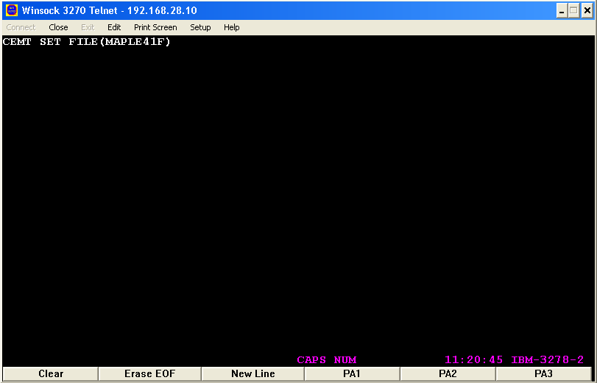
Notes:
The file that is to be used in the application should be loaded and the entry should be made in the FCT table with the fileid.This is done by giving ‘CEMT SET FILE(MAPLE41F’)’ in the cics region as shown here.

Slide 29
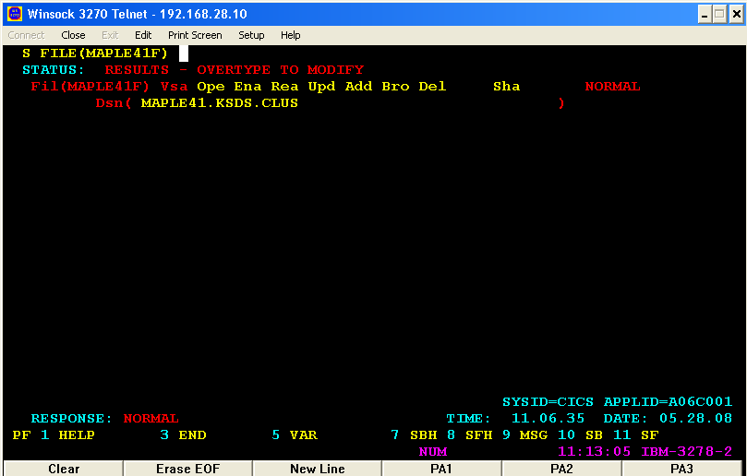
Open & Enable the File
Type the VSAM cluster name
Notes:
The file should be opened and enabled for the various operations to be done. This is done by specifying the name of the cluster in the Dsn and type OPE ENA to open and Enable the file. The RESPONSE should be NORMAL. The possible errors may be NOT ENABLED (when OPE ENA is not specified) and OPEN/CLOSE FAILED (when the cluster is not available)

Slide 30
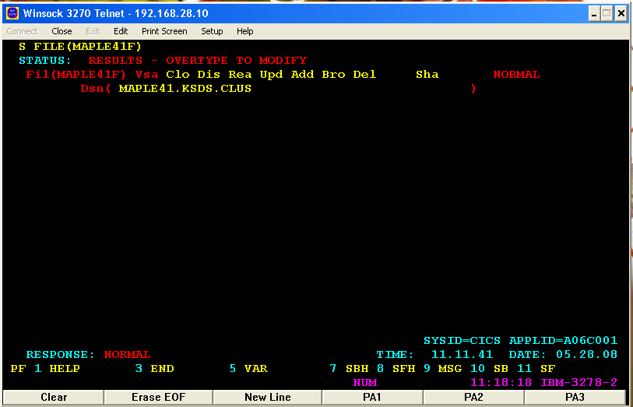
Close & Disable the File
Notes:
To close and disable the file after completion of the task, specify CLO DIS as shown here.

Slide 31
Read the record from File
000001 IDENTIFICATION DIVISION.
000002 PROGRAM-ID. TESTNG.
000003 ENVIRONMENT DIVISION.
000004 DATA DIVISION.
000005 WORKING-STORAGE SECTION.
000006 COPY EMAP.
000007 01 REC1.
000008 02 ENO PIC X(4).
000009 02 FILLER PIC X.
000010 02 ENAME PIC X(15).
000011 02 FILLER PIC X(60).
000012 PROCEDURE DIVISION.
000013 PARA1.
000014 MOVE '1111' TO ENO.
Notes:
Now we’ll see a program to read the record from a file.

Slide 32
000015 EXEC CICS READ
000016 FILE('MAPLE41F')
000017 RIDFLD(ENO)
000018 INTO(REC1)
000019 END-EXEC.
000020 MOVE ENO TO ENOO.
000021 MOVE ENAME TO ENAMEO.
000022 EXEC CICS SEND
000023 MAP('EMP') MAPSET('MAPLE41')
000024 END-EXEC.
000025 EXEC CICS
000026 RETURN
000027 END-EXEC.
000028 STOP RUN.
Notes:
The record ‘1111’ available in the ksds file referred by the file-id MAPLE41F is fetched
(READ) and is moved to the map output variables and is sent to the map.

Slide 33
Read all the records in the file using START BROWSE and READNEXT
000001 IDENTIFICATION DIVISION.
000002 PROGRAM-ID. TTSG.
000003 ENVIRONMENT DIVISION.
000004 DATA DIVISION.
000005 WORKING-STORAGE SECTION.
000006 COPY EMAP.
000007 01 REC1.
000008 02 ENO PIC X(4).
000009 02 PIC X.
000010 02 ENAME PIC X(15).
000011 02 PIC X(60).
000012 77 WS-RESP PIC S9(8) COMP.
000013 PROCEDURE DIVISION.
000014 PARA1.
000015 MOVE "1111" TO ENO.
000016 EXEC CICS STARTBR
000017 FILE('MAPLE41F')
000018 RIDFLD(ENO)
000019 GTEQ
000020 END-EXEC.
Notes:
This program shows the sequential read of all the records from the file MAPLE41F starting from the ENO ‘1111’. The pointer to the file is initialized by the STARTBR command.

Slide 34
000021 PARA2.
000022 EXEC CICS READNEXT
000023 FILE('MAPLE41F')
000024 RIDFLD(ENO)
000025 INTO(REC1)
000026 RESP(WS-RESP)
000027 END-EXEC.
000028 IF WS-RESP = DFHRESP(ENDFILE)
000029 GO TO PARA3
000030 ELSE
000031 MOVE ENO TO ENOO
000032 MOVE ENAME TO ENAMEO
000033 EXEC CICS SEND
000034 MAP('EMP') MAPSET('MAPLE41')
000035 END-EXEC
000036 EXEC CICS DELAY
000037 INTERVAL(000005)
000038 END-EXEC
000039 GO TO PARA2.
000040 PARA3.
000041 EXEC CICS ENDBR
000042 FILE('MAPLE41F')
000043 END-EXEC.
000044 EXEC CICS
000045 RETURN
000046 END-EXEC.
000047 STOP RUN.
Notes:
The successive records are read using the READNEXT command till the end-of–file is reached which is identified by the ENDFILE condition. Every record that is read is displayed in the map with a delay of 5 seconds. The ENDBR is used when the end-of-file is reached.

Slide 35
Input Data in Map and write the record to File
000001 IDENTIFICATION DIVISION.
000002 PROGRAM-ID. TSTNG.
000003 ENVIRONMENT DIVISION.
000004 DATA DIVISION.
000005 WORKING-STORAGE SECTION.
000006 COPY EMAP.
000007 01 REC1.
000008 02 ENO PIC X(4).
000009 02 F PIC X.
000010 02 ENAME PIC X(15).
000011 02 F PIC X(60).
000012 PROCEDURE DIVISION.
000013 PARA1.
000014 MOVE LOW-VALUES TO EMPI, EMPO.
000015 MOVE LOW-VALUES TO REC1.
000016 EXEC CICS SEND
000017 MAP('EMP') MAPSET('MAPLE41')
000018 END-EXEC.
Notes:
This program illustrates the WRITE command where the input ENO and ENAME is got for every employee in the map and is written to the file identified by the file-id MAPLE41F.

Slide 36
000019 EXEC CICS RECEIVE
000020 MAP('EMP') MAPSET('MAPLE41')
000021 END-EXEC.
000022 MOVE ENOI TO ENO.
000023 MOVE ENAMEI TO ENAME.
000024 EXEC CICS WRITE
000025 FILE('MAPLE41F')
000026 FROM(REC1)
000027 LENGTH(LENGTH OF REC1)
000028 RIDFLD(ENO)
000029 END-EXEC.
000030 EXEC CICS RETURN END-EXEC.
000031 STOP RUN.

Slide 37
Rewrite the record in KSDS File with new values from map.
000001 IDENTIFICATION DIVISION.
000002 PROGRAM-ID. TESTN.
000003 ENVIRONMENT DIVISION.
000004 DATA DIVISION.
000005 WORKING-STORAGE SECTION.
000006 COPY EMAP.
000007 01 REC1.
000008 02 ENO PIC X(4).
000009 02 PIC X.
000010 02 ENAME PIC X(15).
000011 02 PIC X(60).
000012 PROCEDURE DIVISION.
000013 PARA1.
000014 MOVE 'E002' TO ENO.
000015 EXEC CICS READ
000016 FILE('MAPLE41F')
000017 INTO(REC1)
000018 RIDFLD(ENO)
000019 UPDATE
000020 END-EXEC.
Notes:
The record E002 is read with the UPDATE option and is modified or rewritten with the new values received from the user through the map.

Slide 38
000021 MOVE ENO TO ENOO.
000022 MOVE ENAME TO ENAMEO.
000023 EXEC CICS SEND
000024 MAP('EMP') MAPSET('MAPLE41')
000025 END-EXEC.
000026 EXEC CICS RECEIVE
000027 MAP('EMP') MAPSET('MAPLE41')
000028 END-EXEC.
000029 MOVE ENOI TO ENO.
000030 MOVE ENAMEI TO ENAME.
000031 EXEC CICS REWRITE
000032 FILE('MAPLE41F')
000033 FROM(REC1)
000034 LENGTH(LENGTH OF REC1)
000035 END-EXEC.
000036 EXEC CICS
000037 RETURN
000038 END-EXEC.
000039 STOP RUN.

Slide 39
Delete the Record in KSDS file
000001 IDENTIFICATION DIVISION.
000002 PROGRAM-ID. TSTN.
000003 ENVIRONMENT DIVISION.
000004 DATA DIVISION.
000005 WORKING-STORAGE SECTION.
000006 COPY EMAP.
000007 01 REC1.
000008 02 ENO PIC X(4).
000009 02 PIC X.
000010 02 ENAME PIC X(15).
000011 02 PIC X(60).
000012 PROCEDURE DIVISION.
000013 PARA1.
000014 MOVE LOW-VALUES TO EMPI, EMPO.
000015 MOVE 'E009' TO ENO.
Notes:
This program shows the deletion of record E009 from the file identified by MAPLE41F.

Slide 40
000016 EXEC CICS READ
000017 FILE('MAPLE41F')
000018 INTO(REC1)
000019 RIDFLD(ENO)
000020 UPDATE
000021 END-EXEC.
000022 EXEC CICS SEND
000023 MAP('EMP') MAPSET('MAPLE41')
000024 END-EXEC.
000025 EXEC CICS DELETE
000026 FILE('MAPLE41F')
000027 RIDFLD(ENO)
000028 END-EXEC.
000029 EXEC CICS RETURN END-EXEC.
000030 STOP RUN.

Slide 41
Try Yourself !
Write programs to write records into KSDS file.The record may have student details.(try with ESDS and RRDS as well)
Write a program to access the record at random from KSDS file. (ESDS,RRDS as well)
Write a program to access all the records sequentially from the KSDS file(ESDS, RRDS also)

